Slide 1
Capstone Project-1
Ds Chargers: Hotel Boking Analysis
Team Member Pooja Parsana Robin Rego Chetan Jadhav

Slide 2
Outline
Exploring and Cleaning the Dataset
To establish relationship between various features of the Dataset.
Present these relationships using various Data Visualization Techniques.
Draw the useful insights from it.
Conclusion.

Slide 3
Data Summary
GUEST
PARKING
IF CAR
How many time Repeat Customer type
BOOKING
ROOM
Market Segment Year of arrival Type of Deposit Total member per reservation Booking Count
Type of Room Reserve Type of room most assign

Slide 4
Data Summary
This data set contains booking information for a city hotel and a resort hotel includes information such as when the booking was made, length of stay, the number of adults, children and babies, and the number of available parking spaces, among other things. We had hotel Booking dataset of city hotel as well as Resort hotel which was to be analysed and proper insights should be taken out which can be useful to provider in future for making important decisions. The dataset which was provided include columns like cancelled Booking, arrival Day/Date/month/year of customer, market segment type, number of family members, type of meal, type of room etc.

Slide 5
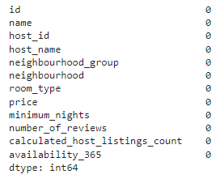
Exploring and Cleaning the Dataset
The first step is download dataset and check the missing value and null value.

Slide 6
EDA (Exploratory data analysis)
The main purpose of EDA is to assist check out data before making any assumptions. It can help identify obvious errors, also as better understand patterns within the info, detect outliers or anomalous events, and find interesting relations among the variables. There are four primary sorts of EDA: Univariate Non-Graphical Univariate Graphical Multivariate Non-graphical Multivariate Graphical

Slide 7
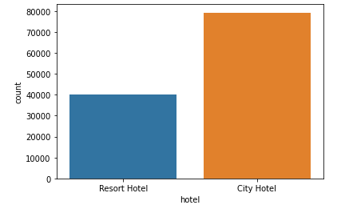
EDA
Hotel Vs Count

Slide 8
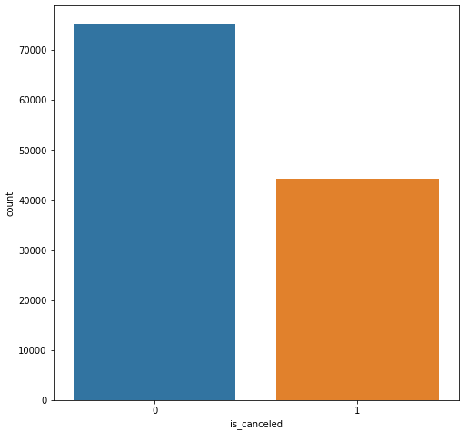
EDA
Booking Count Vs Booking Canceled

Slide 9
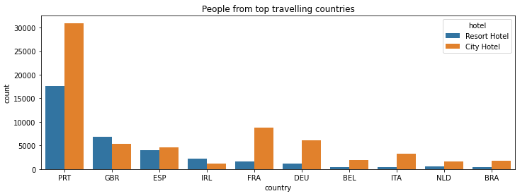
EDA
People from top travelling countries

Slide 10
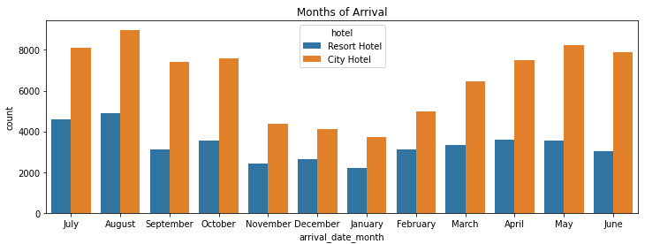
EDA
Months of Arrival

Slide 11
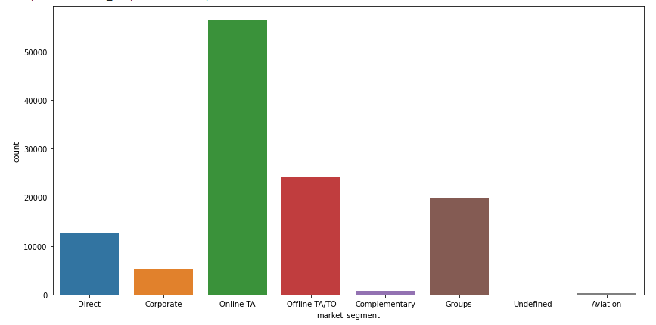
EDA
Market Segment

Slide 12
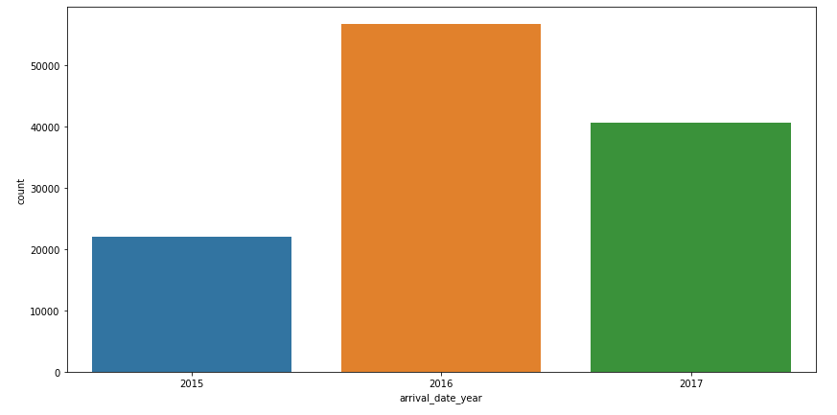
EDA
Arrival Date and Year

Slide 13
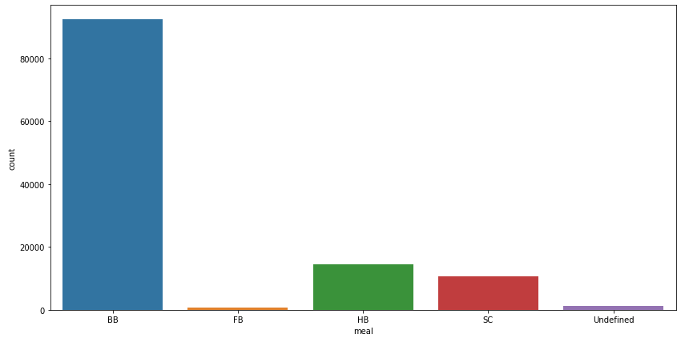
EDA
Type of meal most consumed

Slide 14
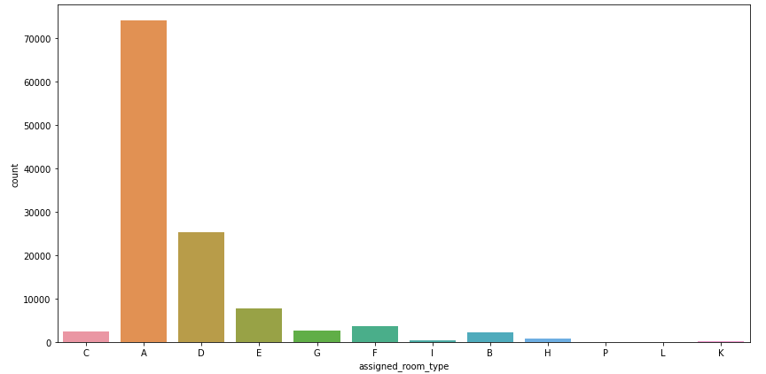
EDA
Most assign Room

Slide 15
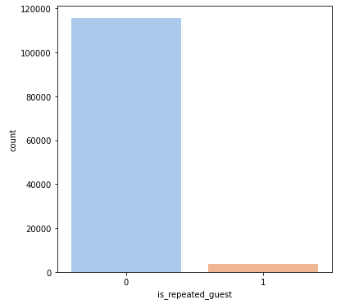
EDA
Repeated Guest

Slide 16
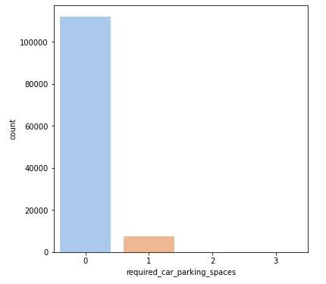
EDA
Parking Spaces

Slide 17
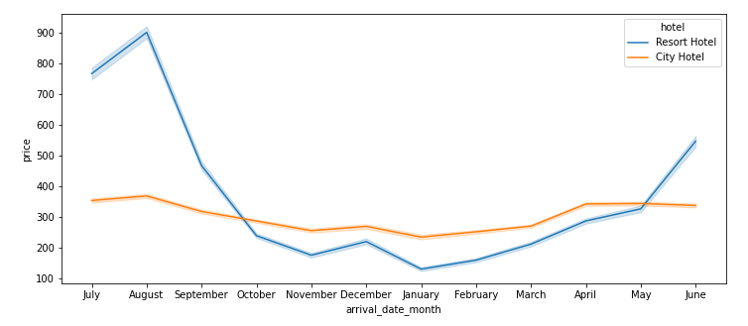
EDA
Arrival date month

Slide 18
Conclusion
A)- Portugal, Great Britain, and France are native place of most customers. B)- August is the most busiest month. C)- Most of our customers were brought in by online Travel Agents. D)- Bed and Breakfast is the most preferred meal package. E)- In 2016, we had most customers considering overall customers whereas city hotel had more booking compared to resort hotels. F)- Most of the time, people come in pair. G)- Room Type A is MOST Favourite room type among customers. H)- The majority of reservations hotels are city hotel. I)- The number of repeated Guests is too low.

